Slide 1
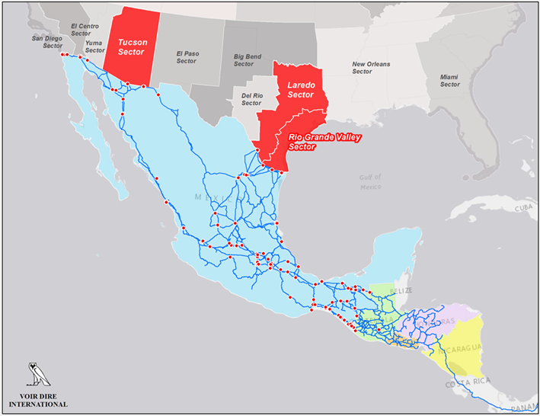
Uncovering Human Smuggling Patterns from Guatemala to the U.S.
VOIR DIRE INTERNATIONAL, LLC

Slide 2
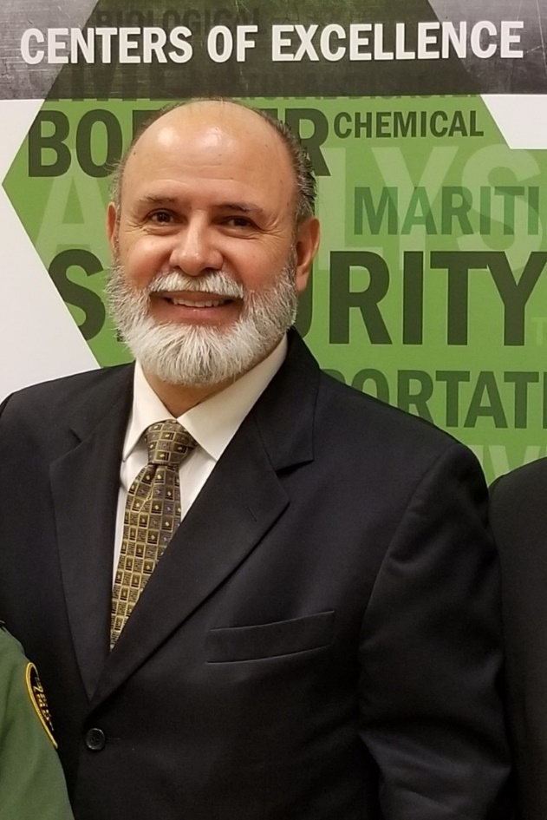
Uncovering Smuggling Patterns from Guatemala to the U.S.
Gary J. Hale
Title: Principal Investigator/CEO Voir Dire International, LLC
Start Date: October 2016
End Date: June 2018
Project Type: Policy Development; Prototype Model for OTM (Northern Triangle) Migrant Stock traversing Mexico
Objective: Determine Unknown Got-Aways variable of the TIR (Total Interdiction Rate) Formula
VOIR DIRE INTERNATIONAL, LLC

Slide 3
Uncovering Human Smuggling Patterns from Guatemala to the U.S.
Research and Analysis Team
Principal Investigator
Gary J. Hale, Principal Investigator and Subject Matter Expert.
examinerhale@hotmail.com or 832-865-7659
Interview Team
Alfonso Moreno – Survey Coordinator
Retired U.S. Border Patrol
alfonsom@joalvarez.com or 956-237-1393
Jesus Yzquierdo (Laredo Sector)
Retired U.S. Border Patrol
jdyzq@Hotmail.com or 956-744-5776
Jose Gonzalez (Laredo Sector)
Retired U.S. Border Patrol
fjtoy70@Hotmail.com or 956-744-4323
Gabriel Bustamante (Rio Grande Valley Sector)
Retired U.S. Border Patrol
gggbustama@aol.com or 956-455-3238
Eugene Montes, Jr. (Rio Grande Valley Sector)
Retired U.S. Border Patrol
meangreen2010@gmail.com or 956-793-8574
Gary J. Hale (Tuscon Sector)
Retired DEA, Chief of Intelligence
examinerhale@Hotmail.com or 832-865-7659
Rosalind Lawson Hale (Tucson Sector)
Certified Spanish Linguist, Voir Dire International
Rosalindlawson@gmail.com or 202-905-5123
Research Team
Nathan P. Jones, PhD, Human Subjects Research SME
Sam Houston State University
natejudejones@gmail.com or 619-942-0081
Adam N. Hale, MGIS, GIS Analyst/Cartographer
halegeospatial@gmail.com or 210-763-9676
Russell Lundberg, PhD, Statistician
Sam Houston State University
Russell.lundberg@shsu.edu or 424-298-0715
Business Development
“Bif” Browning, Director, Business Development; D.C. Liaison
browingbif@gmail.com or 202-386-2401
VOIR DIRE INTERNATIONAL, LLC

Slide 4
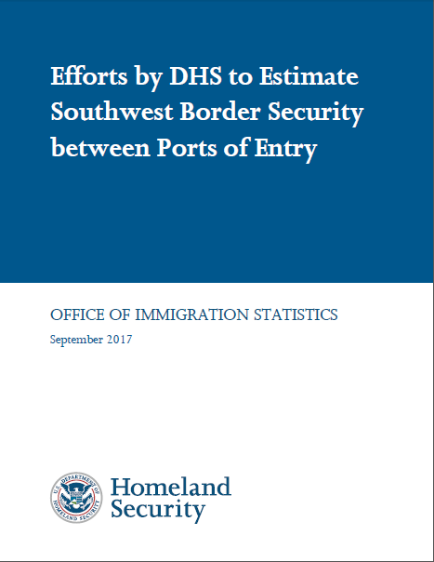
Uncovering Human Smuggling Patterns from Guatemala to the U.S.
VOIR DIRE INTERNATIONAL, LLC

Slide 5
Uncovering Human Smuggling Patterns from Guatemala to the U.S.
PRIMARY OBJECTIVE
The primary research objective is to develop the “Unknown Got-Aways” element of the Total Interdiction Rate (TIR) Formula. The TIR is comprised of the following formula:
The Voir Dire calculus will assist in “validating or refining a methodology for estimating total illegal inflows” (Efforts by DHS to Estimate Southwest Border Security between Ports of Entry OIS, September 2017, page 5).
VOIR DIRE INTERNATIONAL, LLC

Slide 6
Uncovering Human Smuggling Patterns from Guatemala to the U.S.
CONCEPTUAL DEVELOPMENT
There are known knowns. These are things we know that we know.
There are known unknowns. These are things that we know we don't know.
But there are also unknown knowns. There are things we think we know, but it turns out that we didn’t know…(The Unknown Got-Aways)
- Donald Rumsfeld
VOIR DIRE INTERNATIONAL, LLC

Slide 7
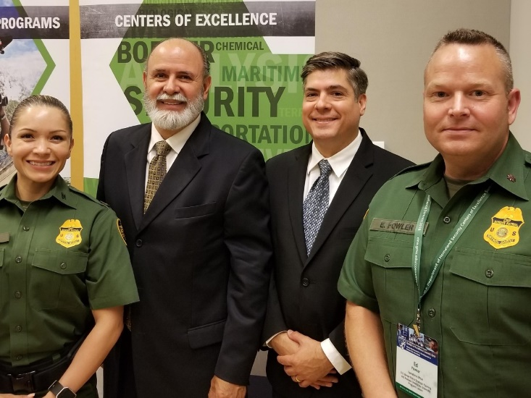
Uncovering Human Smuggling Patterns from Guatemala to the U.S.
SECONDARY OBJECTIVES
This project also provides the following statistically valid data to USBP regarding:
Central American Migrant Push-pull factors
Smuggler contracts
Migrant motivations
Migrant perceptions of U.S. government immigration policy under the Trump Administration
VOIR DIRE INTERNATIONAL, LLC

Slide 8
Uncovering Human Smuggling Patterns from Guatemala to the U.S.
DATA COLLECTION METHODOLOGY
Conducted approximately 270 surveys of OTM migrants primarily from The Northern Triangle (at Laredo, Rio Grande Valley and Tucson Border Patrol Sectors)
Conducted Open Source Research to identify facilities that support migrants in Mexico (charities, for profit, non-profit, government)
VOIR DIRE INTERNATIONAL, LLC

Slide 9
Uncovering Human Smuggling Patterns from Guatemala to the U.S.
DATA COLLECTION METHODOLOGY
DATA VALIDATION - INTERVIEWS
Interviews were conducted within hours (usually 1-4) of detention and at the first processing facility the migrants encountered. This reduced the chances for bias generated from prolonged contact with other detainees and increased the validity of the responses.
Interviewers were identified as academics versus law enforcers. This improved the chances for obtaining truthful responses and increased the validity of the responses
The interviews were conducted on varying shifts (days, evening and nights) at three separate locations, increasing the validity of the responses.
VOIR DIRE INTERNATIONAL, LLC

Slide 10
Uncovering Human Smuggling Patterns from Guatemala to the U.S.
DATA COLLECTION METHODOLOGY
DATA RANDOMIZATION - INTERVIEWS
270 Central American migrants primarily from the Northern Triangle were interviewed at 3 locations generating randomization of response data.
The interviews were made part of the USBP Processing Center flow and individual migrant selection was made by USBP Agents based on a next-available basis, increasing randomization.
The interviews were conducted on varying shifts (days, evening and nights) at three separate locations, increasing randomization.
VOIR DIRE INTERNATIONAL, LLC

Slide 11
Uncovering Human Smuggling Patterns from Guatemala to the U.S.
DATA COLLECTION METHODOLOGY
DATA VALIDATION – SHELTERS
Locations of shelters were determined by self-reporting on the internet and independently verified by Google street views and media reporting
Capacity of the shelters was determined by self-reporting and independent media reports on the internet about shelter capacity (the number of beds available).
.
Migrants provided anecdotal estimates regarding shelter utility at locations where they overnighted. These occupancy or utility rates were not used in the following calculus due to limited validity, but they tend to provide corroboration.
VOIR DIRE INTERNATIONAL, LLC

Slide 12
Uncovering Human Smuggling Patterns from Guatemala to the U.S.
CONCEPTUAL CALCULUS
Successful
Illegal
Entries
(Unknown Got Aways)
OTM Stock
(Northern Triangle)
Apprehensions
VOIR DIRE INTERNATIONAL, LLC

Slide 13
Uncovering Human Smuggling Patterns from Guatemala to the U.S.
CONCEPTUAL CALCULUS
DEFINING OTM STOCK
OTM Stock is the number of migrants from the Northern Triangle countries
that are traversing Mexico at any given time
OTM Stock is also equal to our definition of Network Capacity
OTM Stock
(Northern Triangle)
Apprehensions
Successful
Illegal Entries
(Unknown Got Aways)
VOIR DIRE INTERNATIONAL, LLC

Slide 14
Uncovering Human Smuggling Patterns from Guatemala to the U.S.
CONCEPTUAL CALCULUS
DEFINING “GROSS” NETWORK CAPACITY
n=S₂₆₆
Σ
NC =
n
n=S₁
Network Capacity = NC
Migrant shelter = “S”; (There are 266 total shelters)
(S₁…S₂₆₆)
Ex. S₁=20 beds, S₂=35 beds…S₂₂₆=40 beds
Network Capacity, NC equals the summation of all the S values
As determined by facility self-reporting and testimonials (blogs, media reports, etc.)
OTM Stock
(Northern Triangle)
Apprehensions
Successful
Illegal Entries
(Unknown Got Aways)
VOIR DIRE INTERNATIONAL, LLC

Slide 15
Uncovering Human Smuggling Patterns from Guatemala to the U.S.
CONCEPTUAL CALCULUS
DEFINING “NET” NETWORK CAPACITY
n=S₂₂₀
Σ
NC =
n
n=S₁
Network Capacity = NC
Migrant shelter = “S”; (There are 220 shelters within 5 mi of all routes)
(S₁…S₂₂₀)
Ex. S₁=20 beds, S₂=35 beds…S₂₂₀=40 beds
Network Capacity, NC equals the summation of all the S values
As determined by facility self-reporting and testimonials (blogs, media reports, etc.)
Utility (U) is defined as the number of beds used in a migrant facility on any given day
Expressed as a percentage
OTM Stock
(Northern Triangle)
Apprehensions
Successful
Illegal Entries
(Unknown Got Aways)
VOIR DIRE INTERNATIONAL, LLC

Slide 16
Uncovering Human Smuggling Patterns from Guatemala to the U.S.
CONCEPTUAL CALCULUS
DEFINING UTILITY OF THE NETWORK CAPACITY
n=S₂₂₀
Σ
NC =
n
(U)
n=S₁
Utility (U) is defined as the number of beds used in a migrant facility on any given day
(U) is expressed as a percentage, ex. 0.60 or 60%
The benchmark for the number of beds used in any migrant facility is based on a
standard Hotel utilization average rate of 60% occupancy (U = 0.60 or 60%)
Occupancy rates in this calculus are also seasonally adjusted, 25% occupancy
OTM Stock
(Northern Triangle)
Apprehensions
Successful
Illegal Entries
(Unknown Got Aways)
VOIR DIRE INTERNATIONAL, LLC

Slide 17
Uncovering Human Smuggling Patterns from Guatemala to the U.S.
CONCEPTUAL CALCULUS
DEFINING UTILITY OF THE NETWORK CAPACITY
n=S₅
S₆=5
Net Utility Formula:
Σ
ACTUAL
VALUE:
20,171
OUTSIDE
BUFFER
NC =
n
5 SHELTERS IN THIS EXAMPLE
*ALL WITHIN 5 MILE BUFFER*
n=S₁
Values: 10+20+10+5+20 = 65
S₁=10
n=S₈
Gross Utility Formula:
Σ
8 SHELTERS IN THIS EXAMPLE
*NO BUFFER APPLIED*,
MULTIPLIED BY HOTEL
OCCUPANCY RATE
NC =
n
(.60)
ACTUAL
VALUE:
23,344.7(.60) =
14,006.82
S₃=10
S₂=20
n=S₁
S₄=5
Values: 10 + 20 + 10 +5 + 20 + 5 + 14 + 40 = 124
124 (.60) = 74.4
n=S₈
S₇=14
Seasonal Utility Formula:
Σ
OUTSIDE
BUFFER
8 SHELTERS IN THIS EXAMPLE,
*NO BUFFER APPLIED*,
MULTIPLIED BY SEASONAL
HOTEL OCCUPANCY RATE
NC =
n
(.25)
ACTUAL
VALUE:
23,344.7(.25) =
5,836.175
S₅=20
n=S₁
S₈=40
Values: 10 + 20 + 10 +5 + 20 + 5 + 14 + 40 = 124
OUTSIDE
BUFFER
124 (.25) = 31
OTM Stock
(Northern Triangle)
Apprehensions
Successful
Illegal Entries
(Unknown Got Aways)
VOIR DIRE INTERNATIONAL, LLC

Slide 18
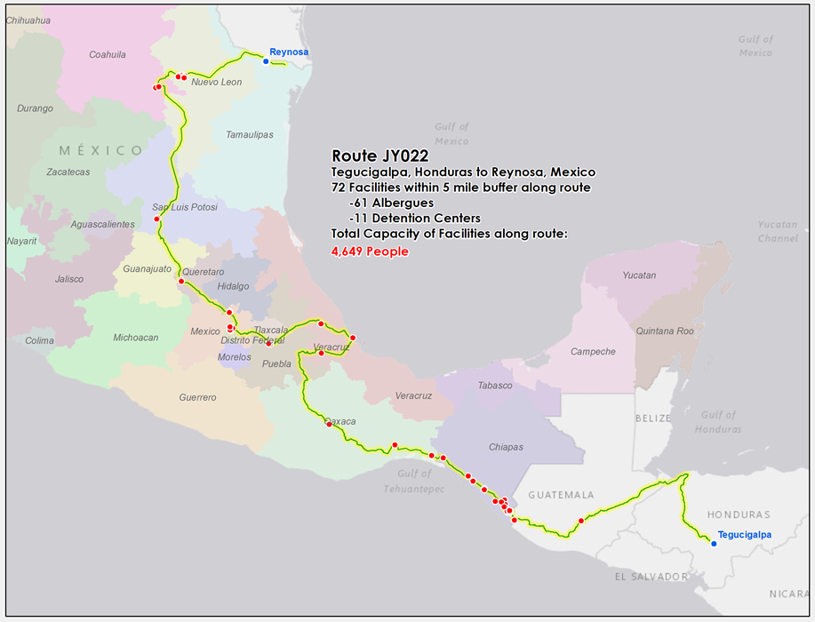
Random Real-World Sample
Of the Calculus in Play

Slide 19
Uncovering Human Smuggling Patterns from Guatemala to the U.S.
ESTIMATE OF NETWORK UTILIZATION
Identified capacity of all routes
Transformed route stock to daily/yearly flow
Incorporated seasonality
Considered a range of utilization rates
VOIR DIRE INTERNATIONAL, LLC

Slide 20
Uncovering Human Smuggling Patterns from Guatemala to the U.S.
FORMULATION OF NETWORK CAPACITY
Capacity Estimates | Tucson | Laredo | Rio Grande
200% of capacity | 38,967 | 89,878 | 122,241
100% of capacity | 19,483 | 44,939 | 61,121
80% of capacity | 15,587 | 35,951 | 48,897
50% of capacity | 97,42 | 22,469 | 30,560
VOIR DIRE INTERNATIONAL, LLC

Slide 21
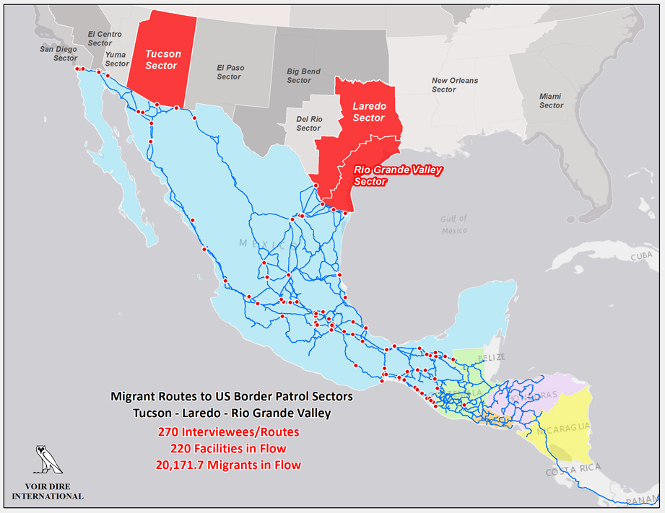
Uncovering Human Smuggling Patterns from Guatemala to the U.S.
VOIR DIRE INTERNATIONAL, LLC

Slide 25
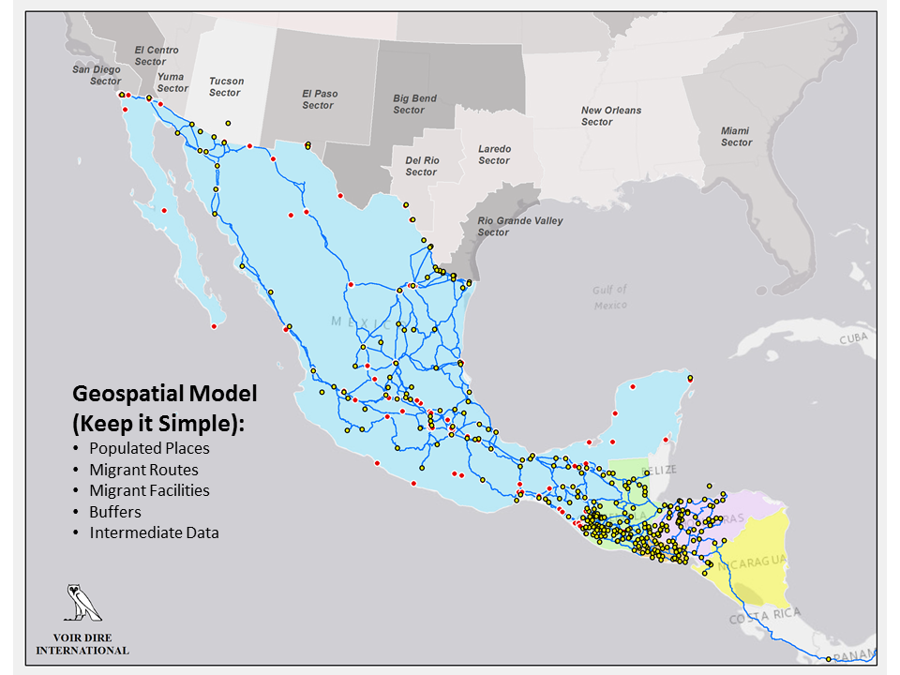

Slide 26
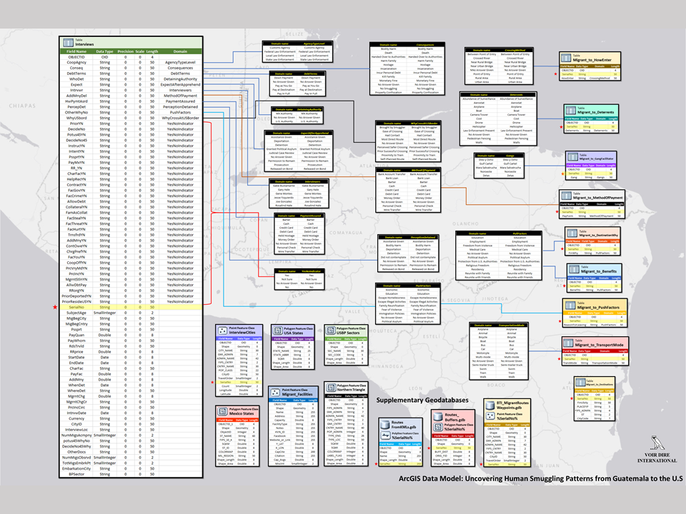

Slide 28
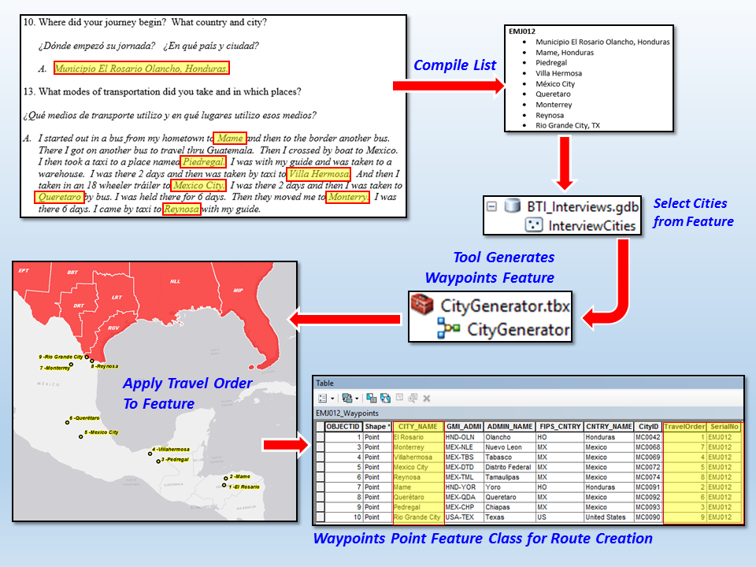

Slide 29
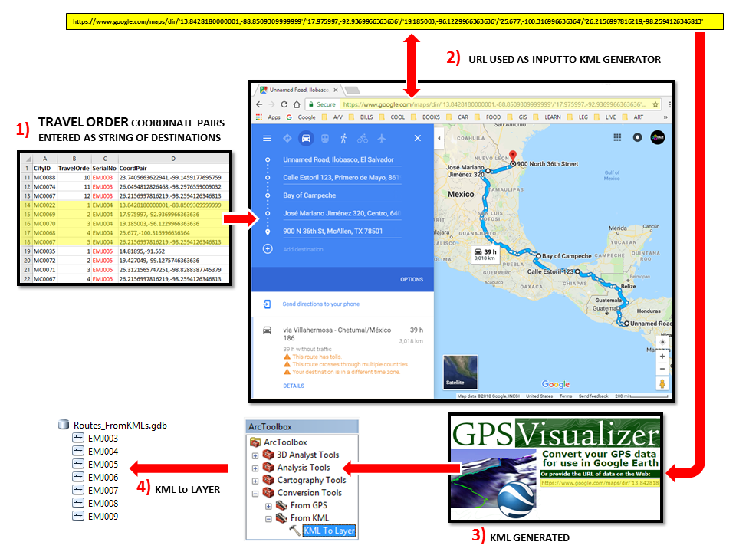

Slide 30
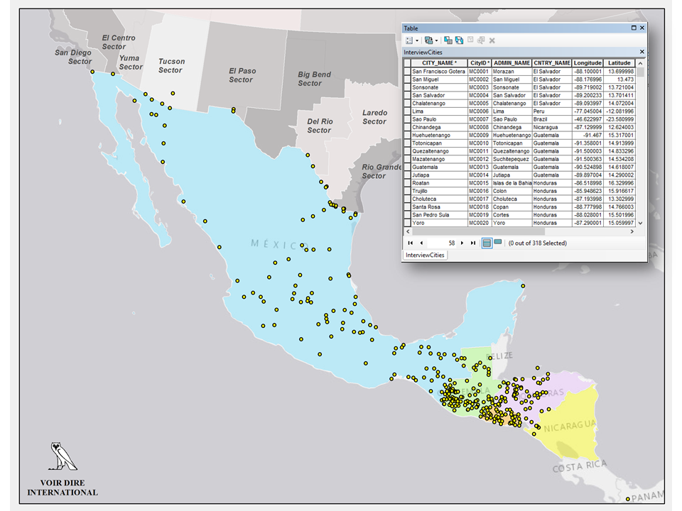

Slide 31
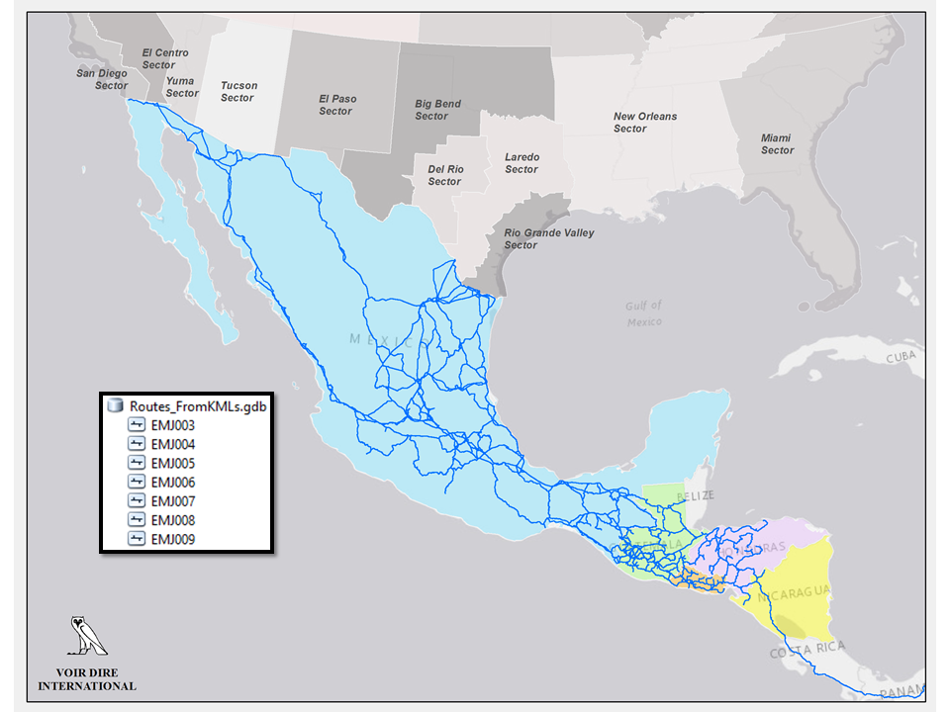

Slide 32
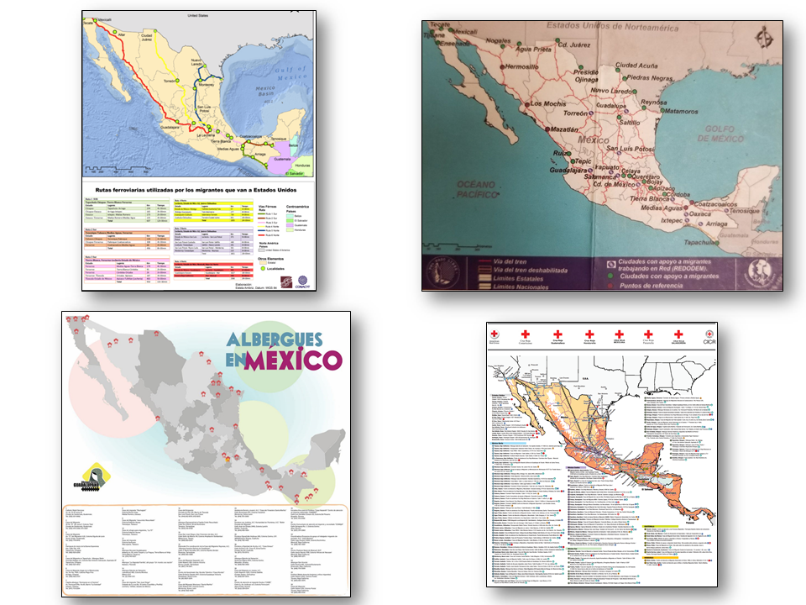

Slide 33
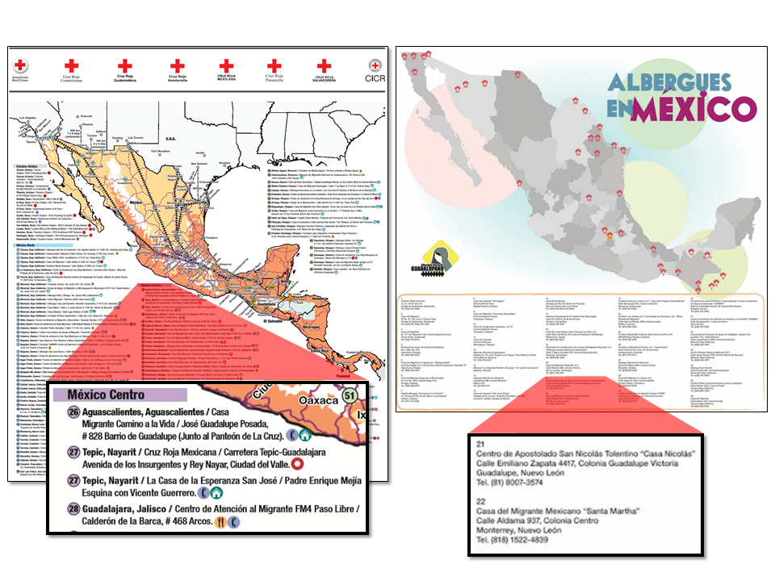

Slide 34
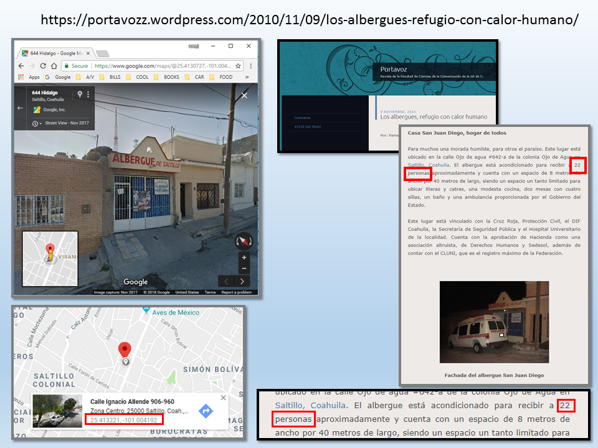

Slide 35
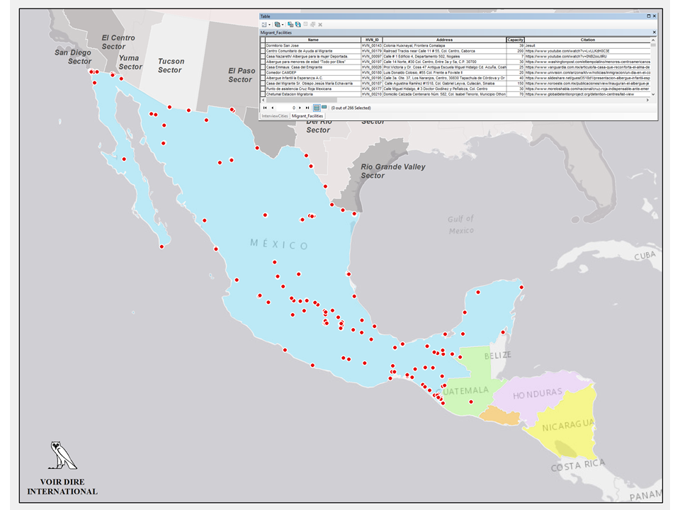

Slide 37
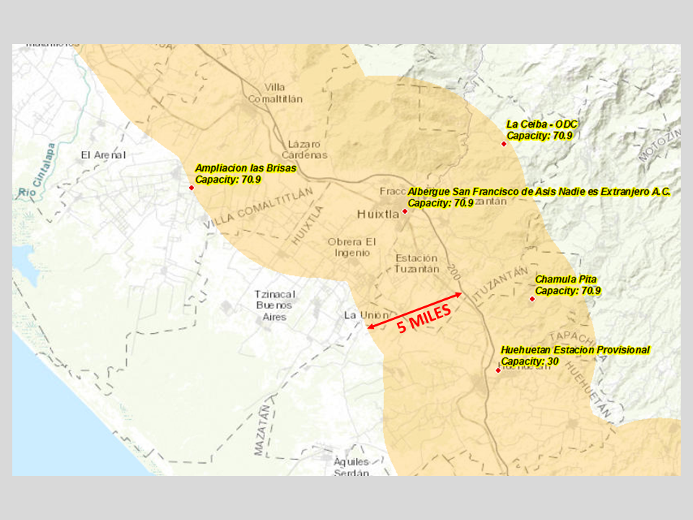

Slide 38
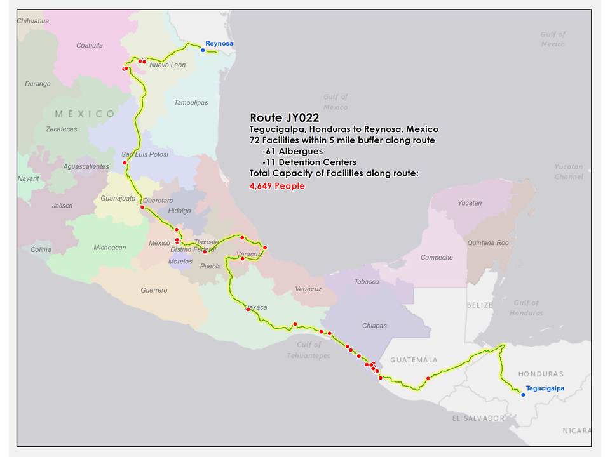

Slide 39
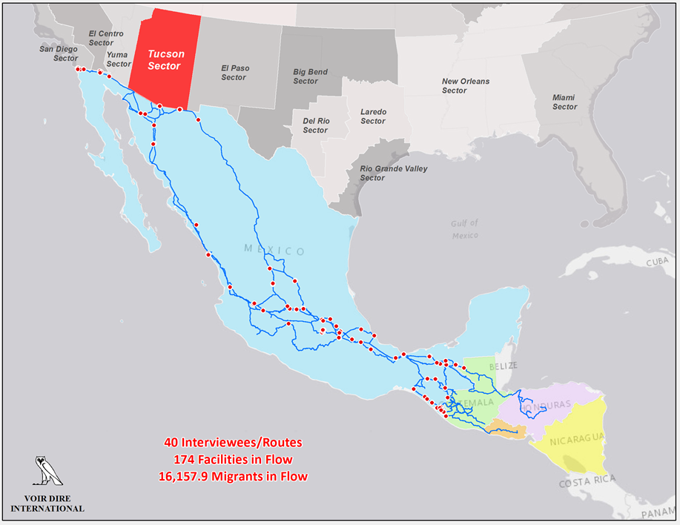
Migrant Routes to US Border Patrol Sector Tucson

Slide 41
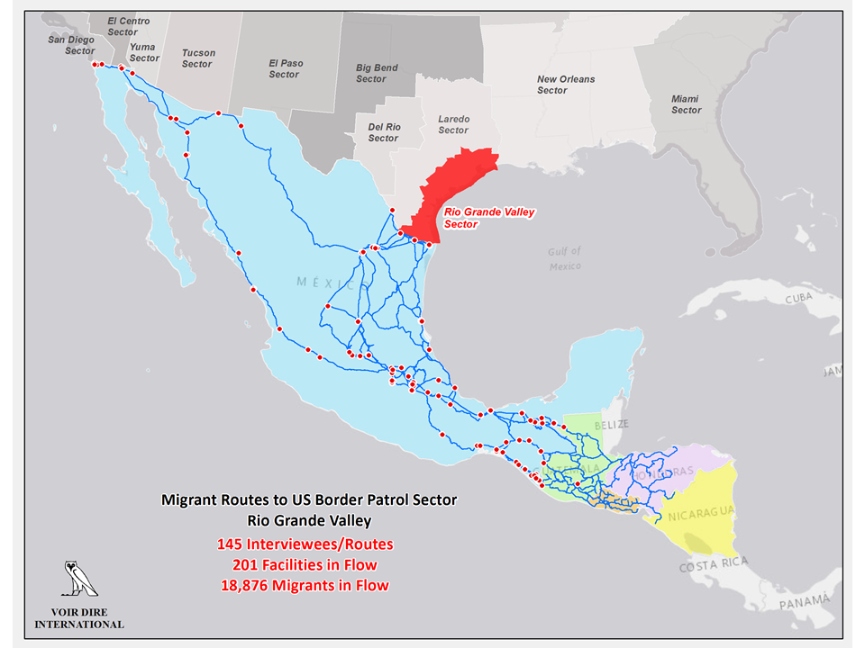

Slide 42
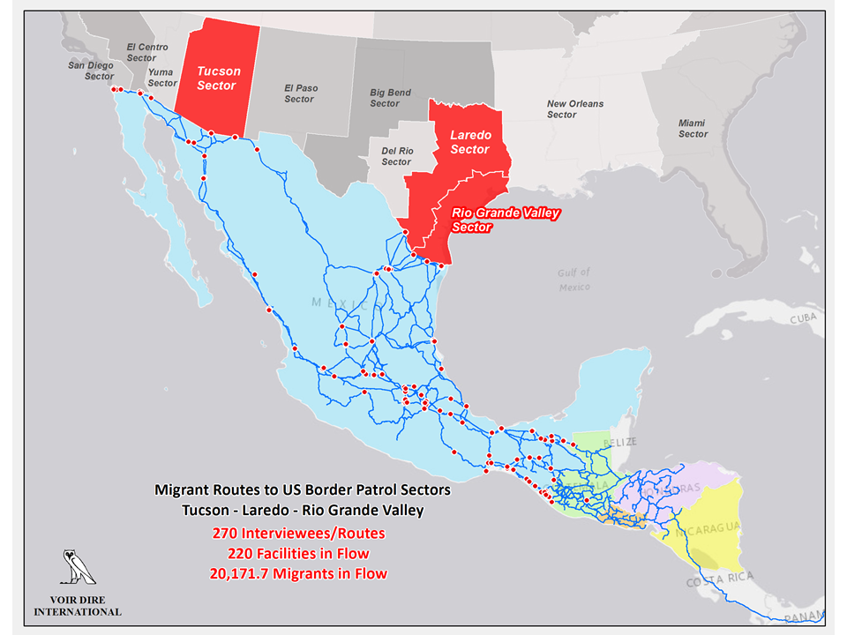

Slide 43
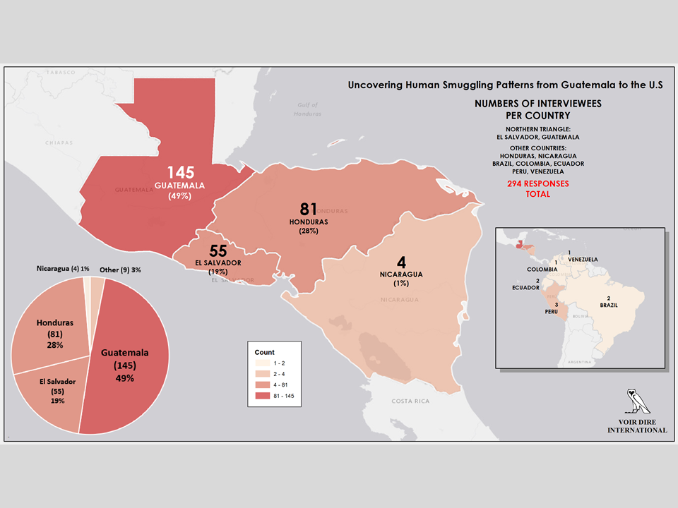

Slide 44
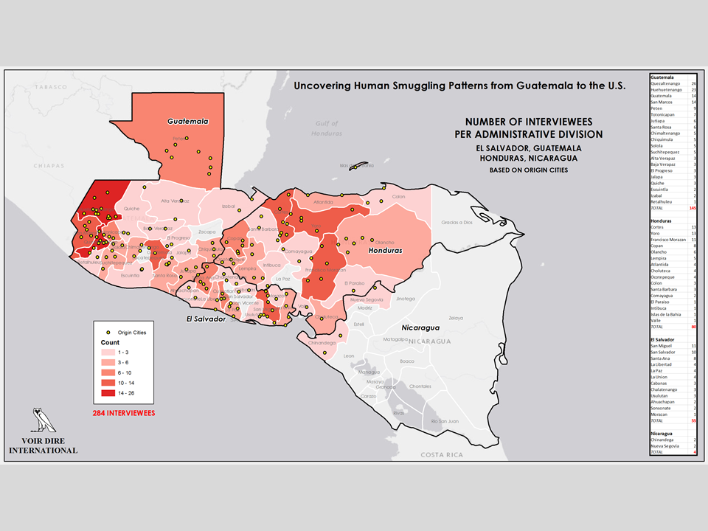

Slide 45
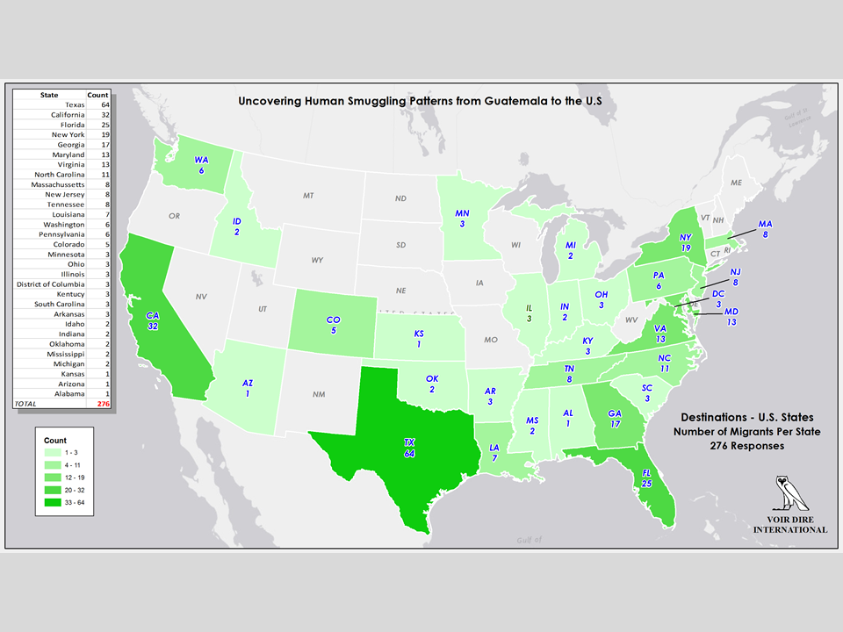

Slide 46
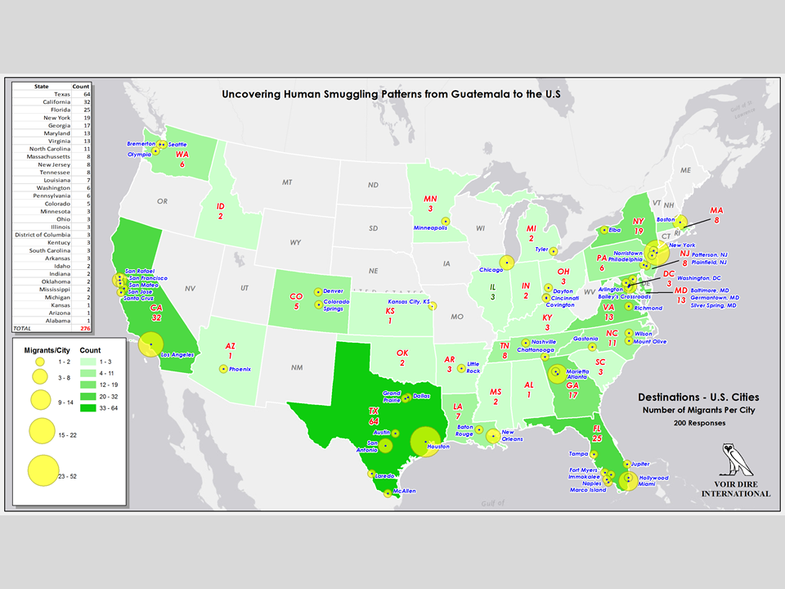

Slide 47
Uncovering Human Smuggling Patterns from Guatemala to the U.S.
RESULTS: TIR CALCULUS
This project collected and analyzed unique data heretofore not used in the TIR calculus.
These results may be used to confirm, refute or validate existing USBP data on migrant flows and migrant arrivals on the Mexico-U.S. border.
VOIR DIRE INTERNATIONAL, LLC

Slide 48
Uncovering Human Smuggling Patterns from Guatemala to the U.S.
RESEARCH PROJECT DELIVERABLES
Voir Dire International will deliver a spatially-enabled database containing spatial and non-spatial data pertaining to interview responses, migrant waypoints, simulated migrant routes and known support structures to estimate the capacity of the estimated illegal entries arriving at the U.S. border.
Voir Dire International will provide a unique calculus that serves as the conceptual basis for the Unknown Got Aways (Estimated Illegal Entries) element of the TIR formula.
Provide a narrative Report detailing the specifics of the analysis including the collection methodology, randomization, validity and other uses including operational/tactical possibilities
VOIR DIRE INTERNATIONAL, LLC

Slide 49
Uncovering Human Smuggling Patterns from Guatemala to the U.S.
POLICY DEVELOPMENT BENEFITS TO DHS AND USBP
Provide DHS the ability to develop and implement specified metrics to measure the effectiveness of security between ports of entry
Provide an alternative response to Presidential and Congressional Mandates (The National Defense Authorization Act of 2017 (H.R. 4909) and Department of Homeland Security Border Security Metrics Act of 2015 with Unknown Got-Aways (Estimated Illegal Entries) Data
Provide an alternative response to the annual "State of the Border" report that includes trends for selected metrics for the last 10 years and selected analysis into related aspects of illegal flow rates; specifically with Unknown Got-Aways (Estimated Illegal Entries) Data.
Provide a narrative Report detailing the specifics of the analysis including the collection methodology, randomization, validity and other uses including operational/tactical possibilities
VOIR DIRE INTERNATIONAL, LLC

Slide 50
Uncovering Human Smuggling Patterns from Guatemala to the U.S.
RECOMMENDATIONS
Fund a Program Extension to collect additional capacity data
Fund a Validation Study to validate utilization rates and other project factors
Fund a contract to merge USBP existing route data with the Mapping Service, collect more data on capacity and utilization of network, manage the Mapping Service for DHS and/or USBP and other requirements
… for the purposes of validating or refining this new conceptual methodology for estimating total illegal inflows.
VOIR DIRE INTERNATIONAL, LLC

Slide 51
Uncovering Human Smuggling Patterns from Guatemala to the U.S.
RESULTS: ANCILLARY REQUIREMENTS
This project also provides the following statistically valid data to USBP regarding:
Current Central American Migrant Push-pull factors
Current smuggler contracts
Current migrant motivations
Current migrant perceptions of U.S. government immigration policy under the Trump Administration
VOIR DIRE INTERNATIONAL, LLC

Slide 52
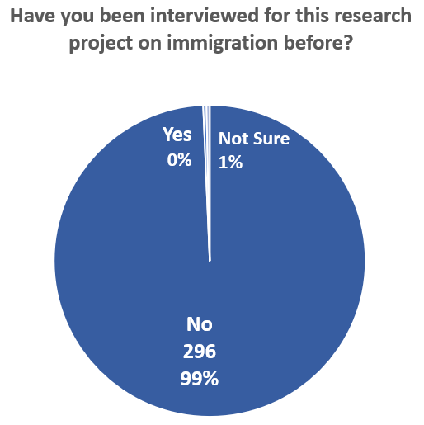
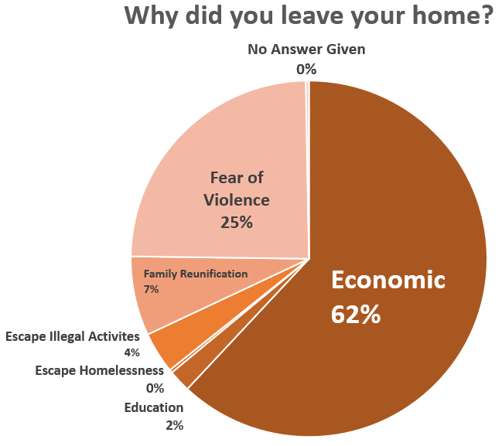
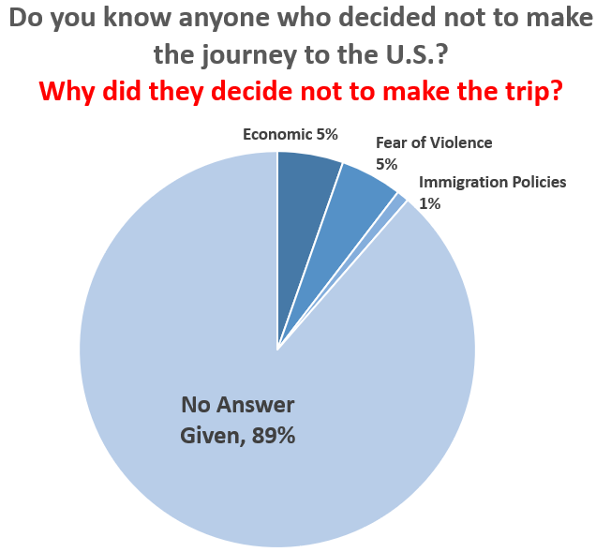
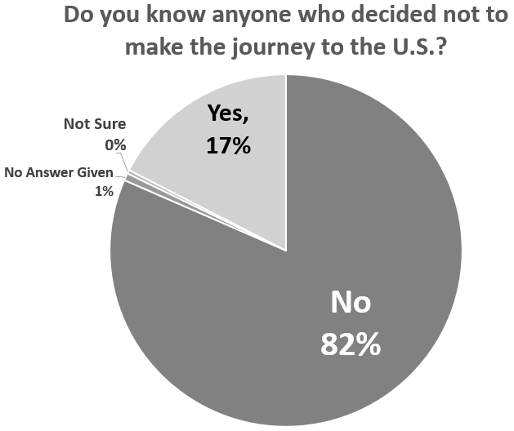
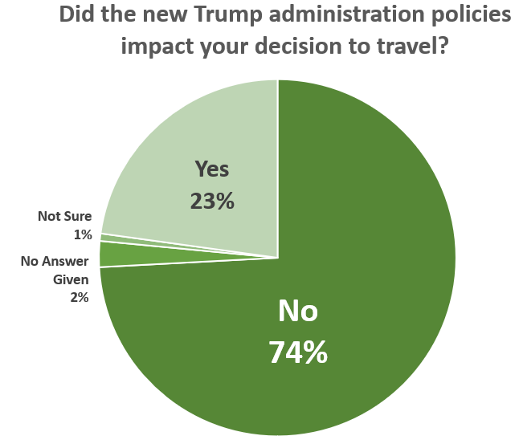
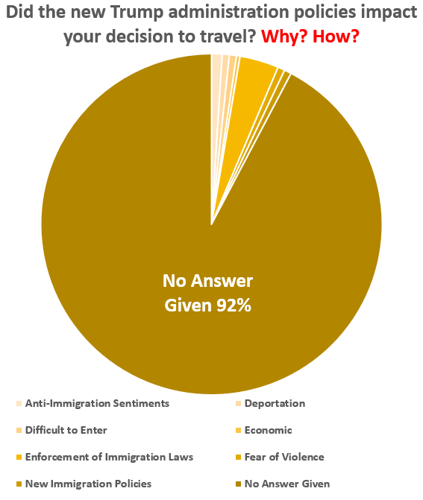
Q1
Q2
Q3
Q3
Q4
Q4

Slide 53
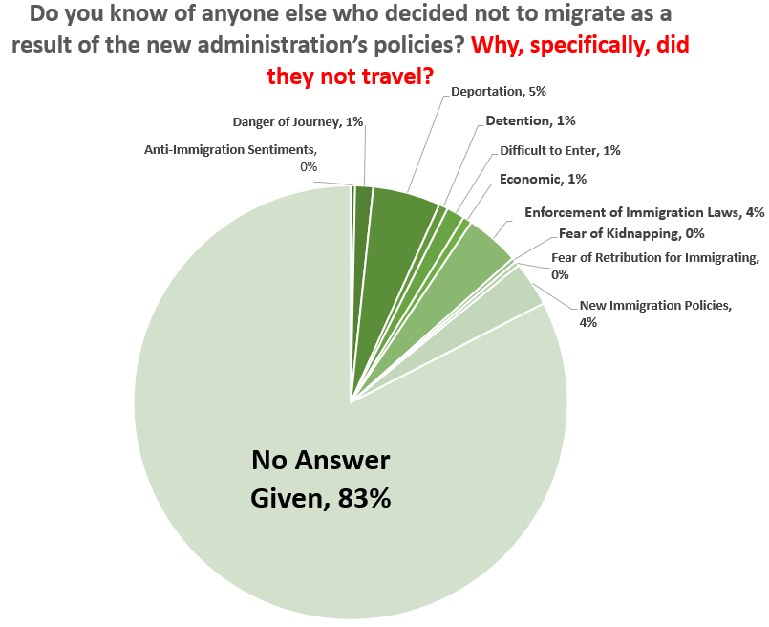
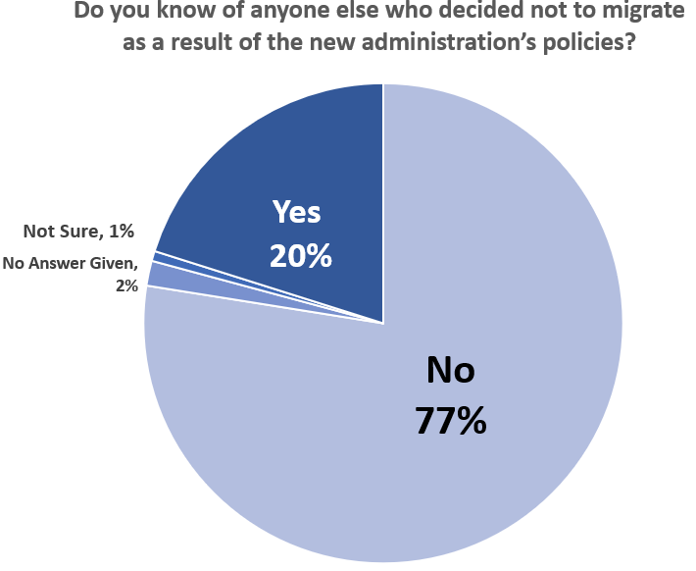
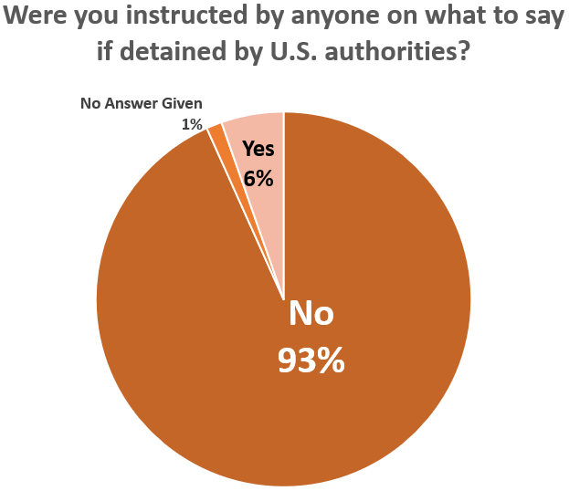
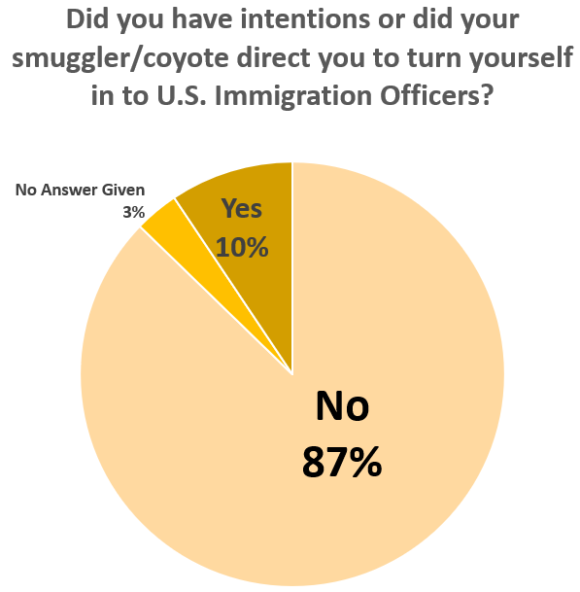
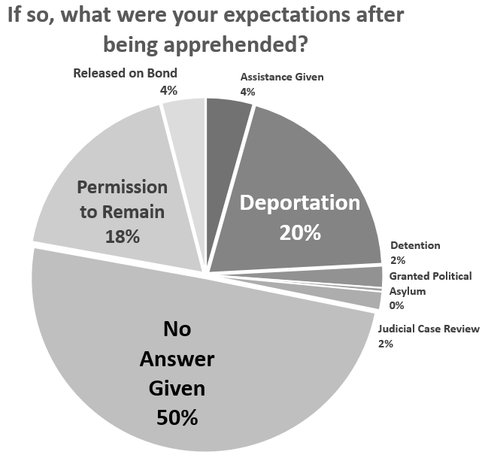
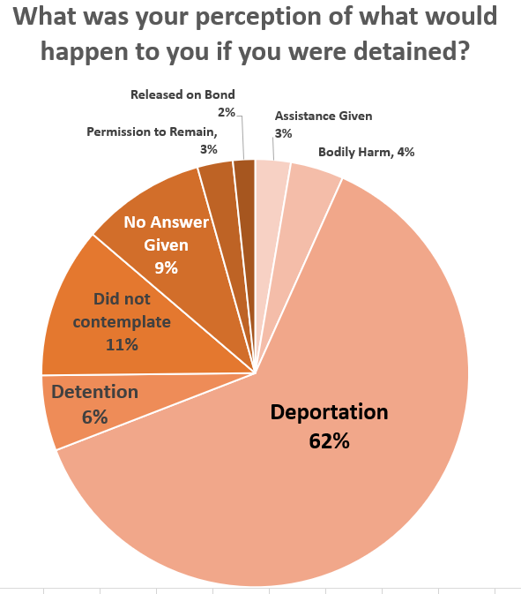
Q5
Q5
Q6
Q7
Q8
Q9

Slide 54
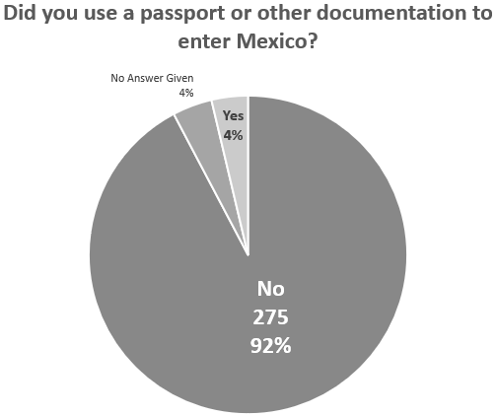
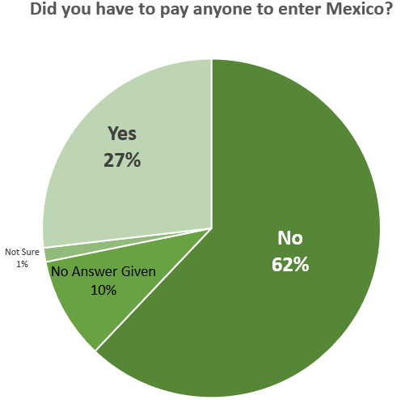
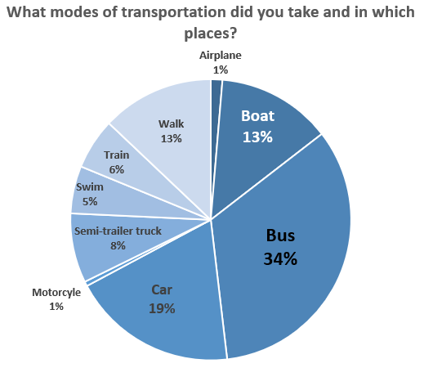
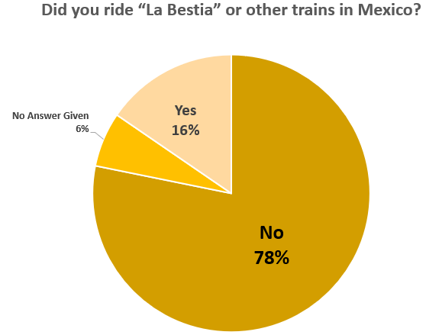
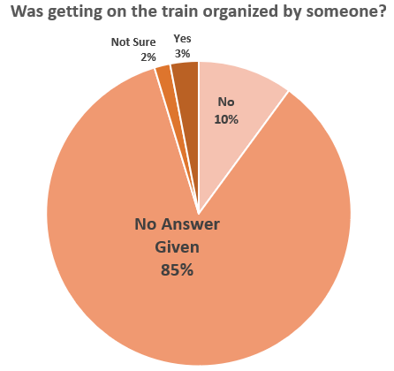
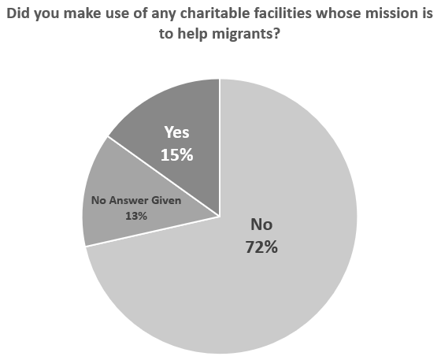
Q11
Q12
Q13
Q16
Q17
Q20

Slide 55
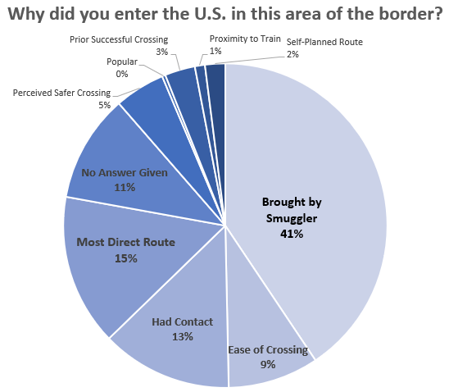
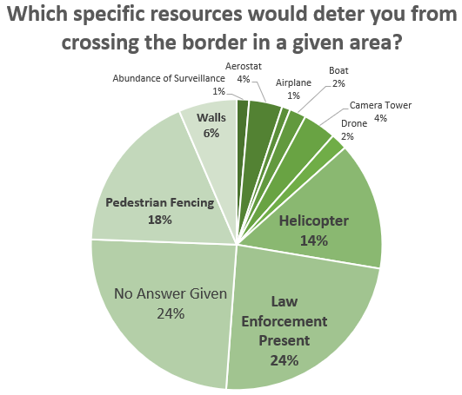
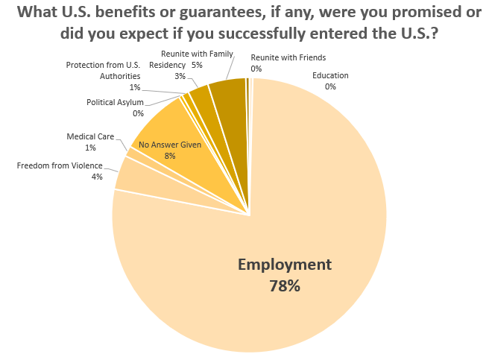
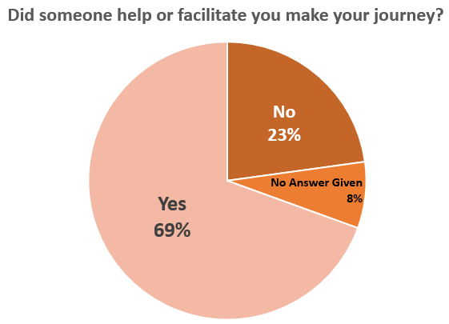
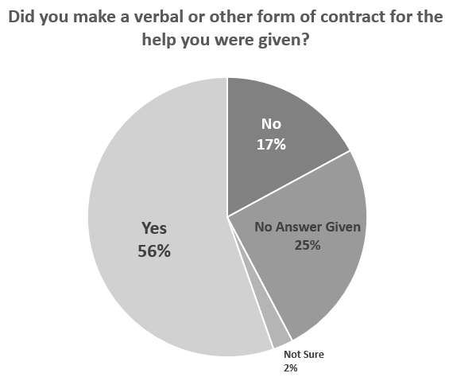
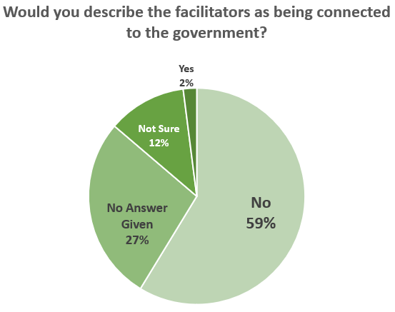
Q21
Q22
Q24
Q25
Q27
Q28

Slide 56
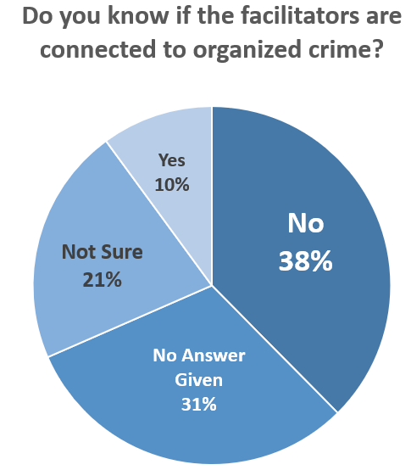
Q29
Q30
Q31
Q31
Q32
Q33

Slide 57
Q34
Q36
Q37
Q38
Q39
Q40

Slide 58
Q40
Q41
Q42
Q43
Q44
Q45

Slide 59
Q47
Q48
Q49
Q51
Q52
Q52

Slide 60
Q53
Q54
Q55
Q56

