Slide 1
Ben Rohrbaugh
Lantern UAS, LLC
Project: Exploring Homeland Security Applications for Unmanned Autonomous Systems at Maritime Ports

Slide 2
Project Overview
Knowledge Gap Addressed: Limitations on containers that can be searched for potential contraband
End-users of this research: Customs and Border Protection
Main outcomes: Additional tool for autonomous search and contraband detection in containers

Slide 3
Project Overview
Goals: The goal of this project is to identify the most useful homeland security applications for unmanned autonomous systems (UAS) technology in a maritime port environment by identifying the highest priorities with regard to contraband detection as determined by DHS requirements and implementing a research and testing plan to validate the use of UAS for such purposes.
Objectives:
Objective 1: Work with DHS and BTI to decide on the initial type of contraband to be targeted in cargo containers using UAS along with signs of potential tampering, which Lantern UAS will propose be radiation sources.
Objective 2: Establish a testing plan to evaluate the sensitivity and specificity of different sensor and camera configurations for onboard UAS operation.
Objective 3: Determine requirements for controlled testing and conduct outreach to necessary partners to identify a location and facility for the testing.
Objective 4: Begin testing in a controlled environment and gathering statistics based on multiple test sources, sensor configurations, and search patterns.
Objective 5: Prepare for testing in a maritime port environment

Slide 4
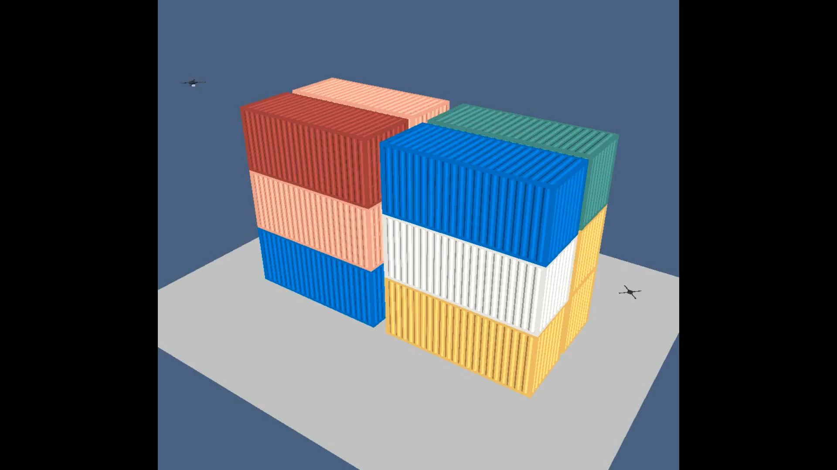
Example of the concept

Slide 5
Milestones
Milestone 1: Determine UAS/sensor configurations and obtain necessary hardware. Determine the contraband types and cargo configurations to be prioritized and find controlled testing location. [On track for completion in anticipated timeframe – by month three]
Milestone 2: Completed CONOPS for UAS operations. Identify which sensor modalities will be most effective for this purpose based on stationary testing. [On track to begin initial testing on schedule – month three]
Milestone 3: Provide report and briefing on results of simulations of sensors being used on UAS and the most effective modalities for sensors used on UAS.
Milestone 4: Begin pilot program in controlled environment.
Milestone 5: Conduct interim review with BTI and project champion.
Milestone 6: Delivery of full report on testing and simulations.

Slide 6
Deliverables
Deliverable 1: Determine the requirements for using UAS to detect contraband and/or tampering in cargo containers at a maritime port, and define configurations of sensor and imaging packages to be tested for this purpose.
Deliverable 2: Begin experiments to determine sensitivity and specificity of sensor and imaging packages and develop CONOPS for port operations and identify controlled environment for testing.
Deliverable 3: Begin testing in controlled environment.
Deliverable 4: Review of simulation and testing in controlled environment and approach potential port partners about testing in the field.
Deliverable 5: Develop full report on research program.
Status: We are on track to begin controlled environment testing on the anticipated timeline
Potential problems: The most significant possible problems are the unanticipated technical challenges that begin when we start to conduct live testing and validate the results of simulations we have conducted.

Slide 7
Performance Metrics
KPI-RI-1: Establishing CONOPS for operations at ports including the key configurations of sensors and UAS, regulatory and requirements, and identified location for controlled testing.
KPI-RI-2: Conducting regular testing of UAS in controlled environment or at port through pilot program and identifying the areas where UAS provide the greatest potential benefit and where there are the largest challenges.
KPI-RI-3: Identifying the sensors and cameras that can most effectively be used by UAS to identify potential security threats and tampering on containers.
KPI-D-1: Provide ongoing feedback on testing pilot program to CBP and other interested components of the homeland security enterprise.
KPI-D-2: Provide final report on the potential merits of UAS operations that can be disseminated to DHS, the scientific community, and to the public.

Slide 8
Question and Answer

